Slide 1
Deep Q-Learning Curriculum
Q-Learning vs Deep Q-Learning
ANN Review
Deep Q-Learning
Experience Replay
Adaptive Epsilon Greedy

Slide 2
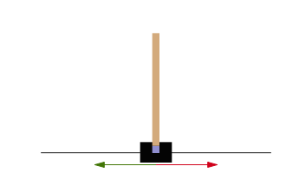
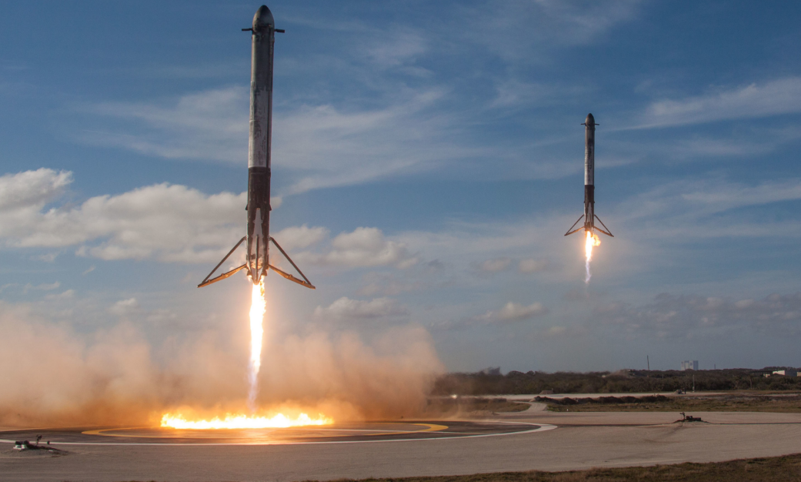
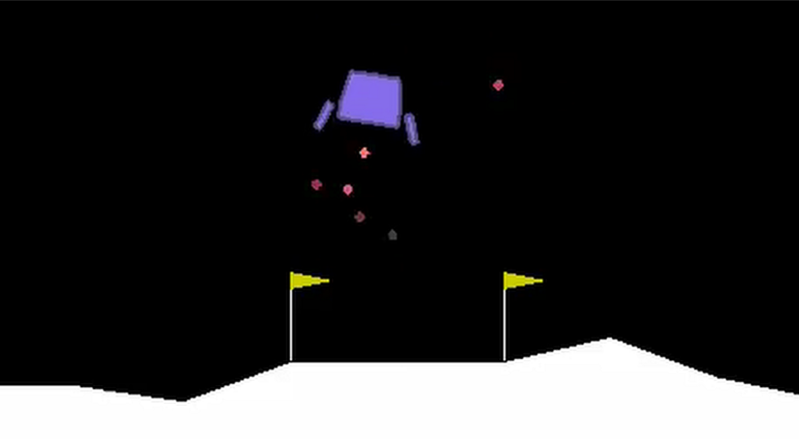
CartPole / Lunar Landing Projects

Slide 3
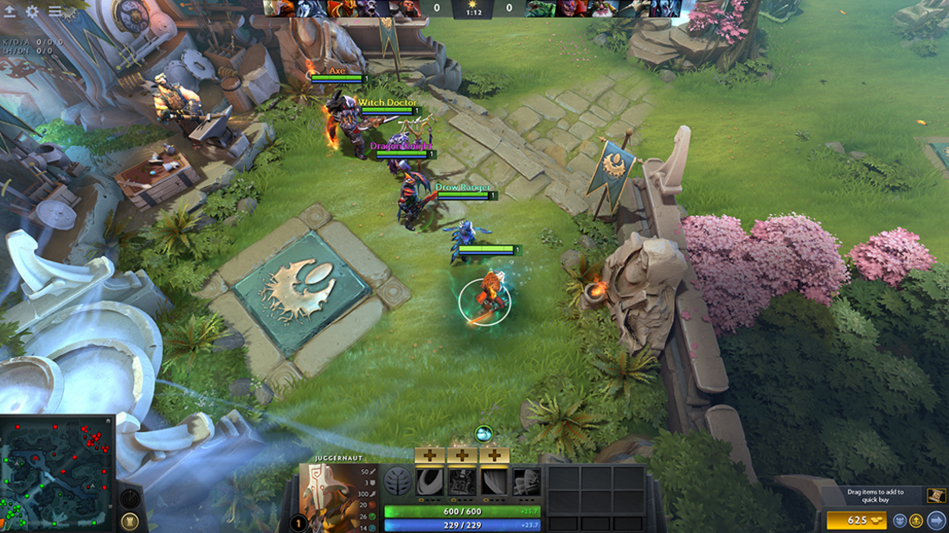
Q-Learning vs Deep Q-Learning
Number of states
Lack of Resource and Performance
https://blog.openai.com/openai-five/
https://www.youtube.com/watch?v=eaBYhLttETw

Slide 4
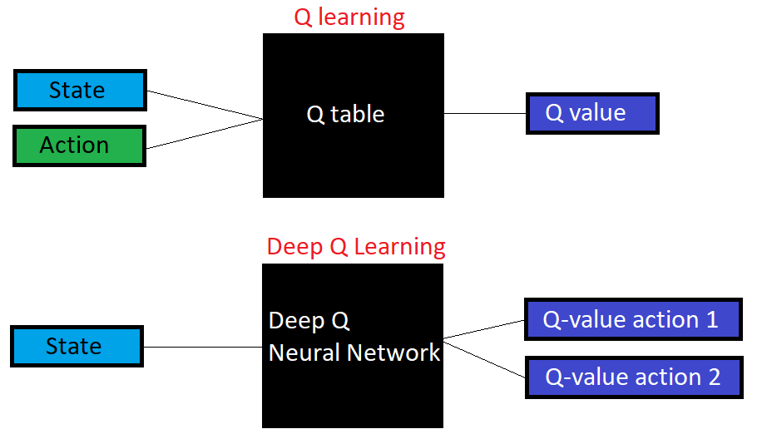

Slide 5
Artificial Neural Network(ANN)
Option1 : Self Learning
Option2 : https://www.kaggle.com/kanncaa1/deep-learning-tutorial-for-beginners
Option 3: Annex 1

Slide 6
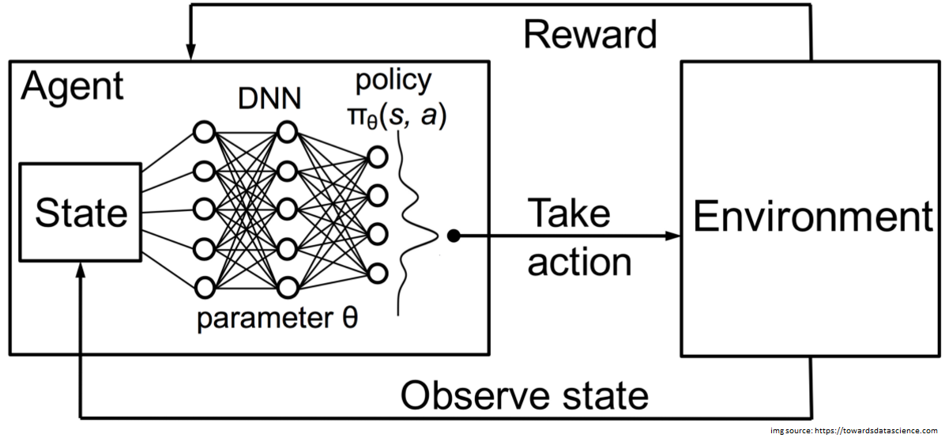
Deep Q-Learning

Slide 7
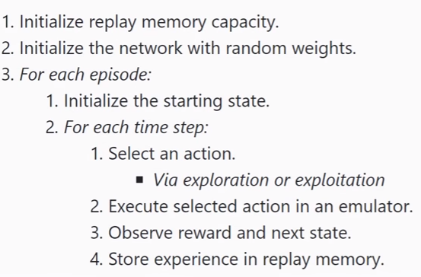
DQL Code

Slide 8
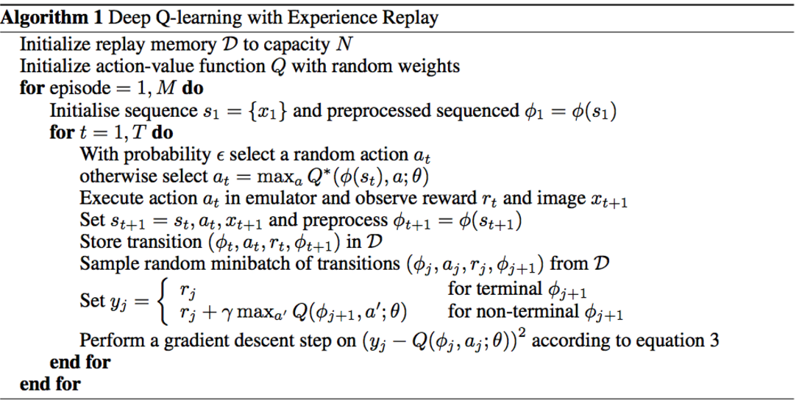

Slide 9
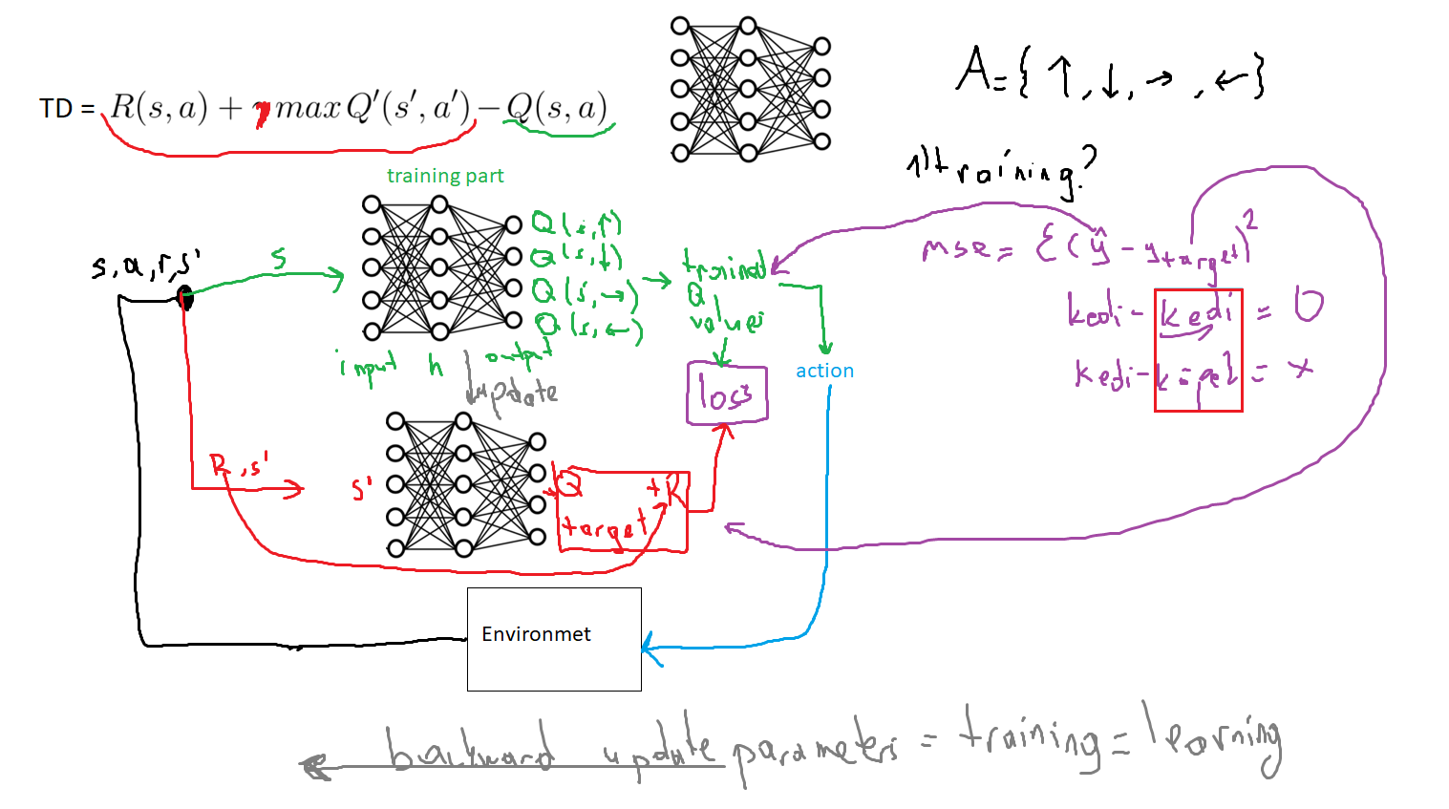

Slide 10
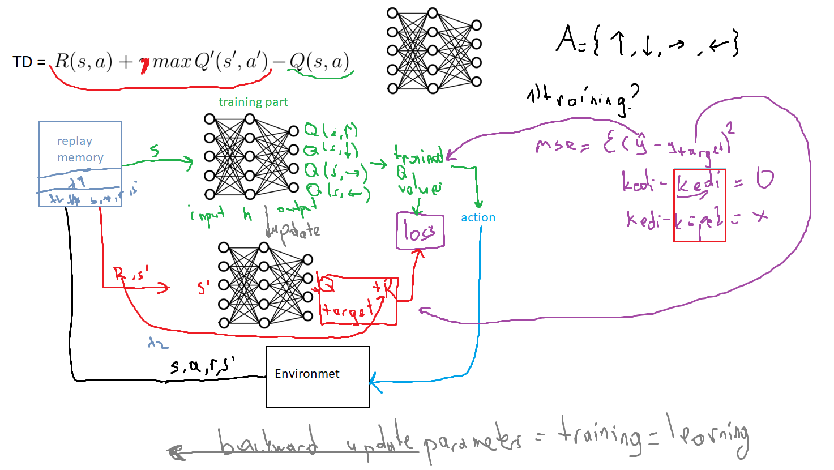
Experience Replay

Slide 11
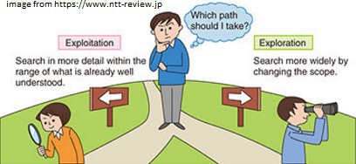




Exploitation vs Exploration

Slide 12
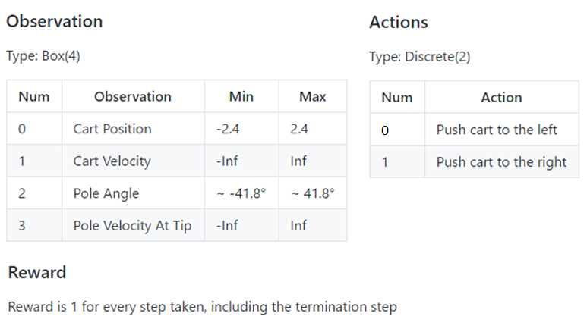
Cartpole

Slide 13
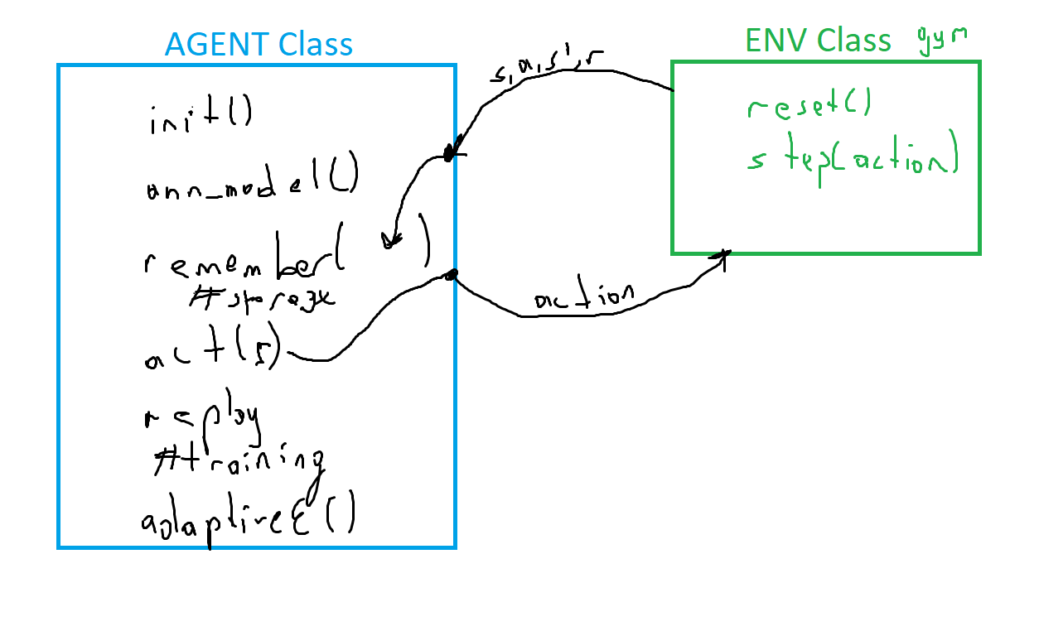
Cartpole Project Template

Slide 14
Lunar Lander
https://gym.openai.com/envs/LunarLander-v2/
https://github.com/openai/gym/blob/master/gym/envs/box2d/lunar_lander.py
http://moonlander.seb.ly/

Slide 15
DQL Results
Q-Learning vs Deep Q-Learning
ANN Review
Deep Q-Learning
Experience Replay
Adaptive Epsilon Greedy

